Slide 1


Welcome to the Session
Aishwarya

Slide 2
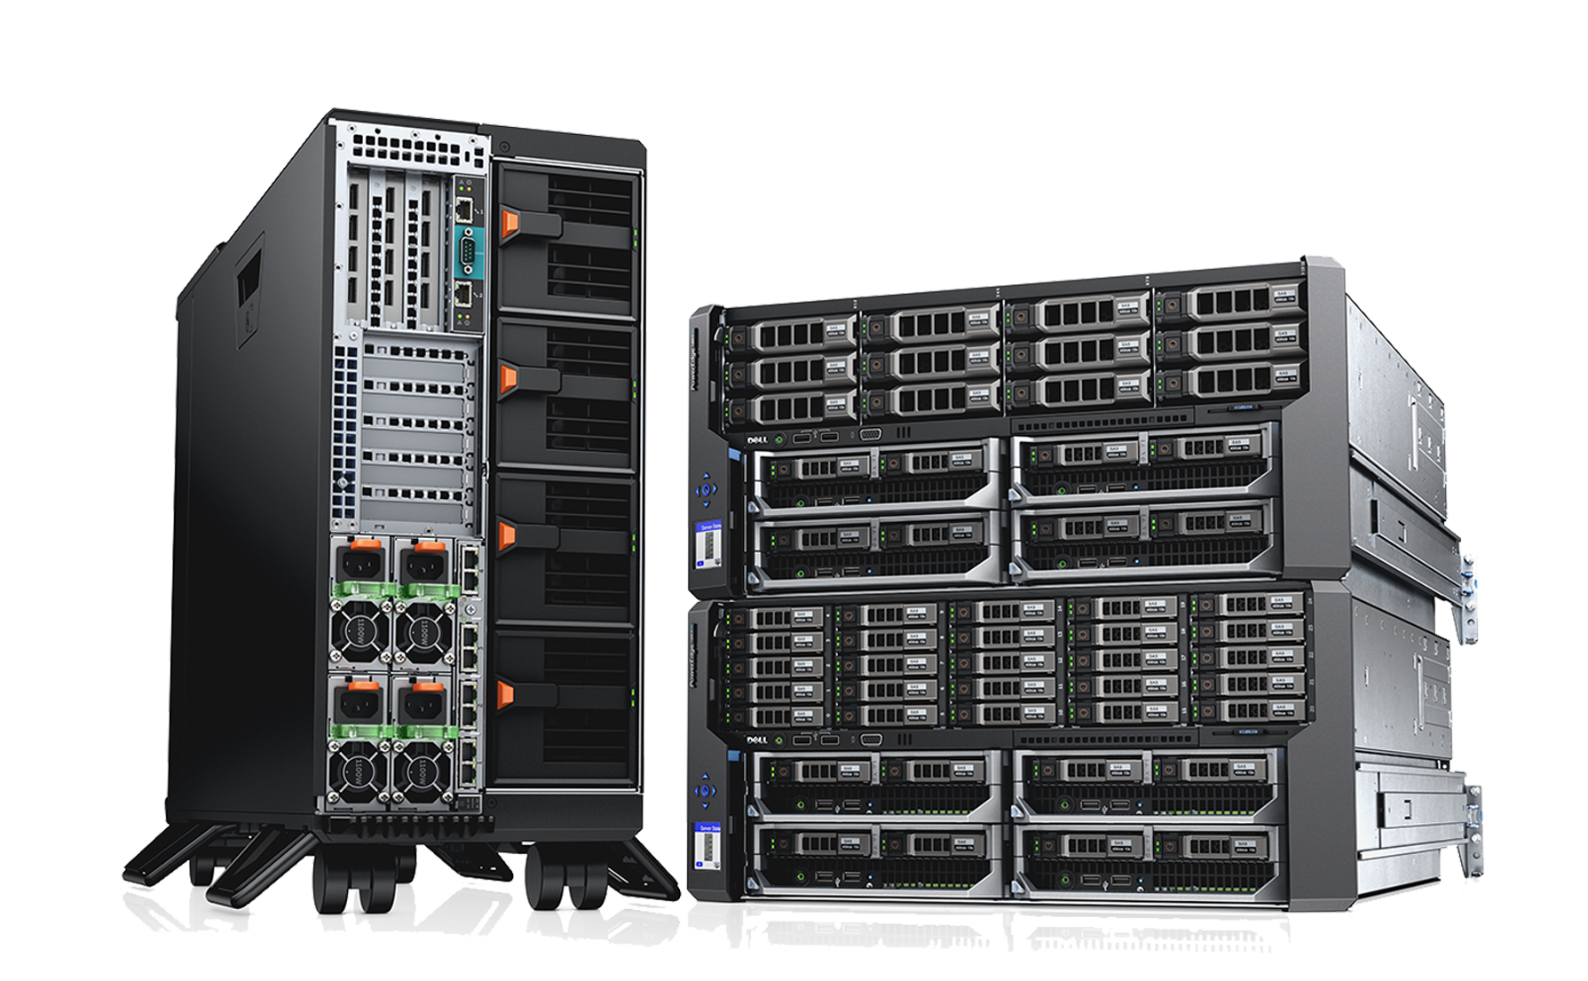
Why should I bother?
In the bad old days, when IT had to deploy a service, we had to purchase a server. Since we don’t want to compromise on performance, we went for a beast m/c most of the time. But actually 99% of time it ran on less capacity. It was under-used.
This was a capex and opex loss.
Also one physical server had one lonely app.

Slide 3
Hello Virtualization
World changed for better and virtualization came.
Now we could run tons of apps on a physical server.
Now used upto it’s capacity. ☺
No longer purchasing of a new server for every new application.
Using the assets to their full capacity
BUT….

Slide 4
It created operational Baggage too…
Vmware and hypervisors did improve the situation but they needed extra management.
Consider 4 VMs over a physical server then we need 4 OS , these also need storage and resources from the physical m/c. So each of the 4 OS would also need storage, reducing the capacity of the machine.
Also they would need –
Admin help for managing OS Licensing costs
Patching Updates etc…
Antivirus management

Slide 5
Say Hello to Containers
Physical server -> 1 OS over it -> many containers over it, each being a slice of the OS.
So now if you have an application you simply fire up one container. And they are pretty fast and come with less capex and opex cost.
DEMO-
Docker Desktop installed on your m/c
Run an Image – a pre-packaged application.

Slide 6

Docker
The company Docker Inc with caps D and the Technology docker.
Docker Inc – company in San Francisco, main company for this open source tech.
They ran containers on AWS and spin it up on AWS.
They used inhouse tech to manage it. And eventually, they made business out of it.
And docker came - dock + worker
Gave world containers…

Slide 7
docker, The Technology
docker tech – apps run in container and docker makes running containers easy.
Opensource (on github) – Community edition
Enterprise edition – official support for enterprise
Demo –
src code -> pack into images -> put the image on docker hub registry - > run the image
So this is how you run one image on a container but…
The world resides at SCALE and that’s where – k8s and docker swarm come into picture. We are going to talk about K8s now.

Slide 8

Kubernetes or K8s
What we will cover –
Why? – covered already
What?
How?

Slide 9
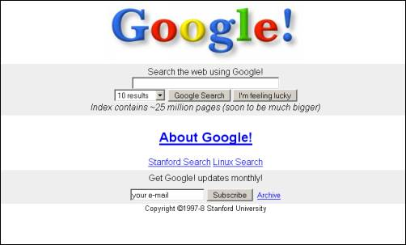
How it came in to picture?
1
In 1990s Google was running it’s services like search engine and even gmail on containers, and since the scale was growing fast , the management of these container can not be manual any more.
2
So they build in-house stuff – first Borg then omega and then came k8s learning from them all.
Amazon google Microsoft all cloud service provider now give k8s services .
On all cloud platforms and even u can have it on prem.
3
K8s – means helmsman in greek – one who steers the ship
4
Recap – docker – mechanics for starting individual containers. Low level
K8s – is high level – how many containers , on which nodes, knowing when to scale with no downtime. K8s acts as a orchestrator. Analogy to the coach of a football team.

Slide 10
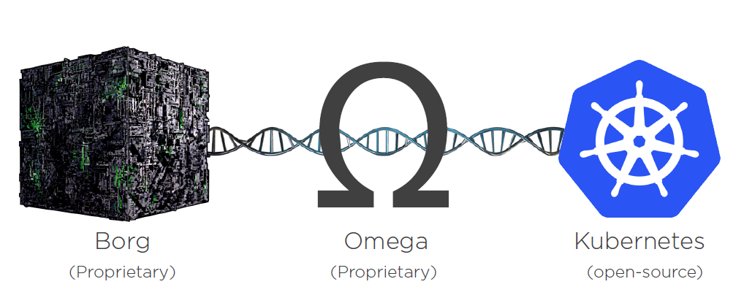

Slide 11
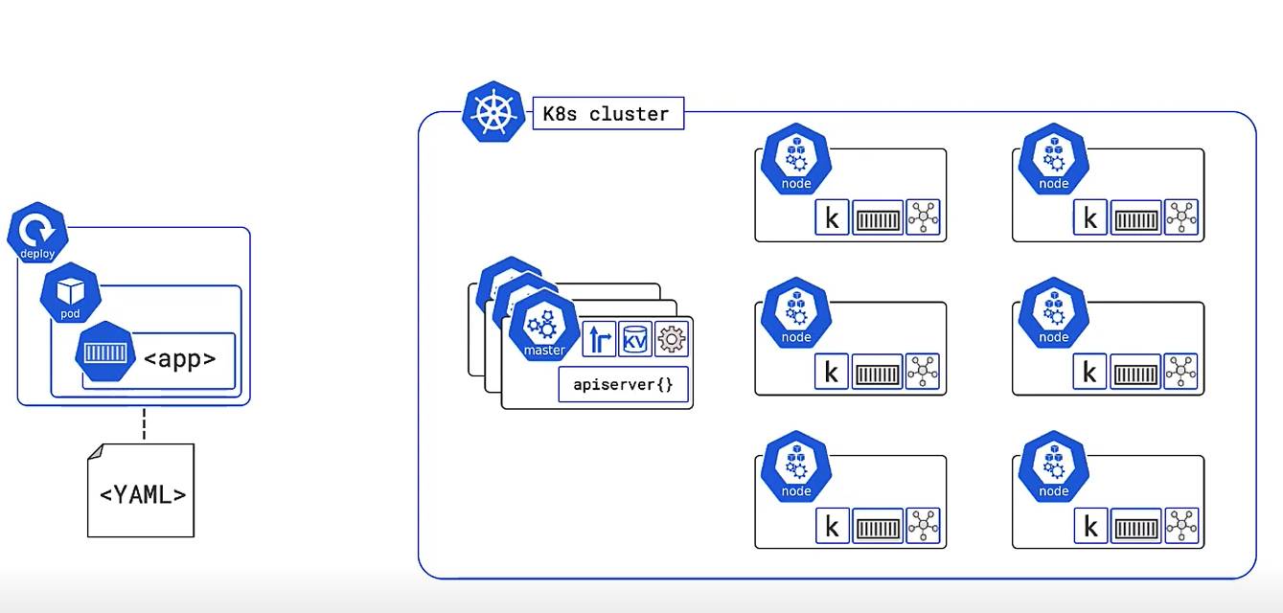
App –> containerized -> on a pod ->which is in deployment, all this specified in a YAML file. And this on right is k8s architecture.

Slide 12
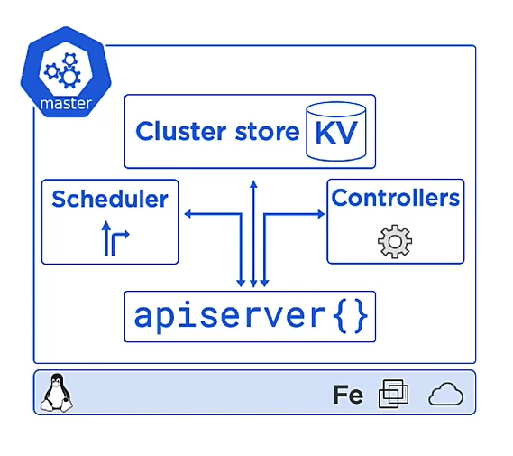
Master Node
Master is the head node. It manages the k8s cluster. It has –
api-server – cmds come via kubectl cli
Cluster store
Controller
Scheduler

Slide 13
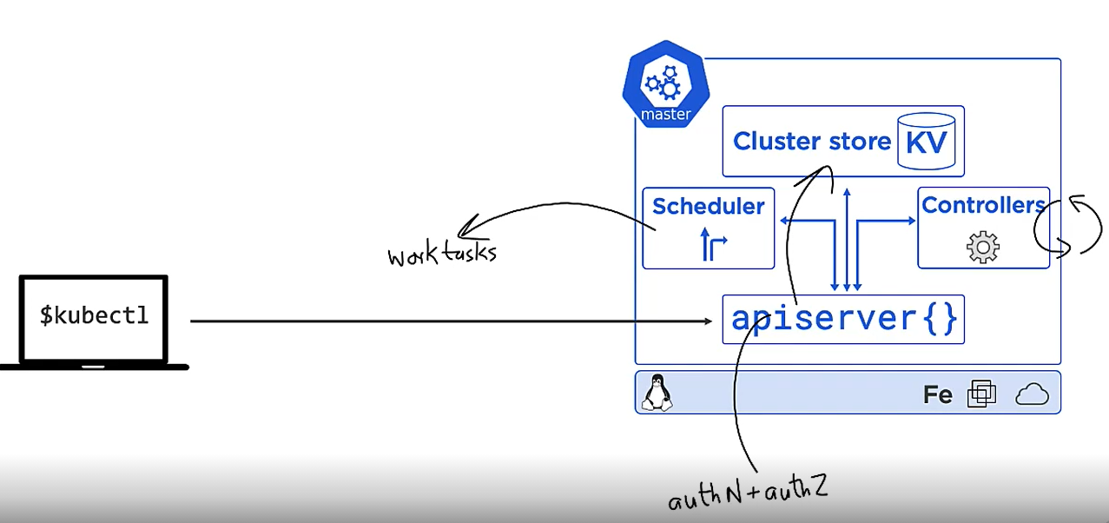
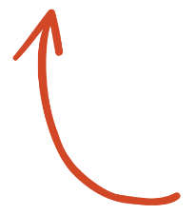
Workflow
SELECT ME

Slide 14
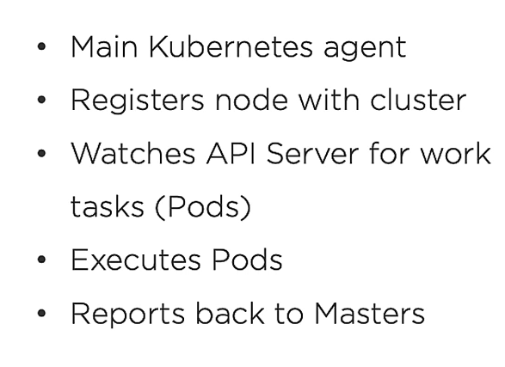
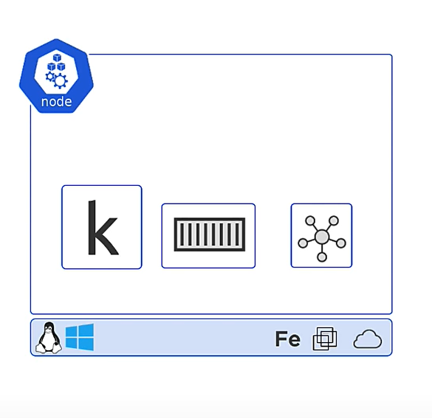
Nodes

Slide 15
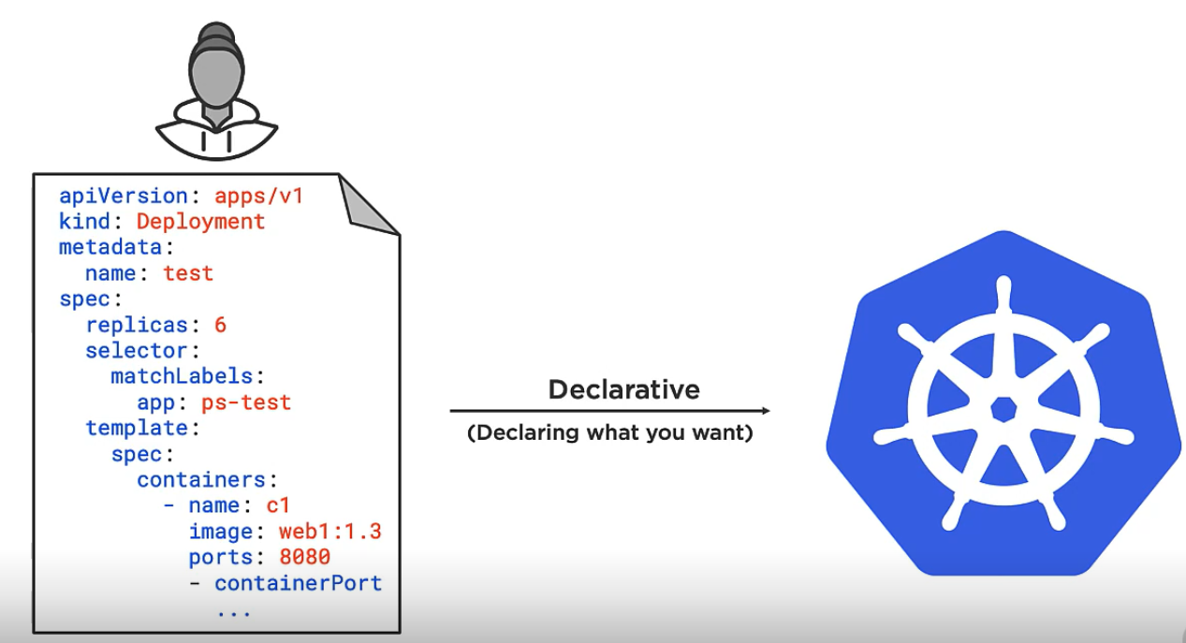
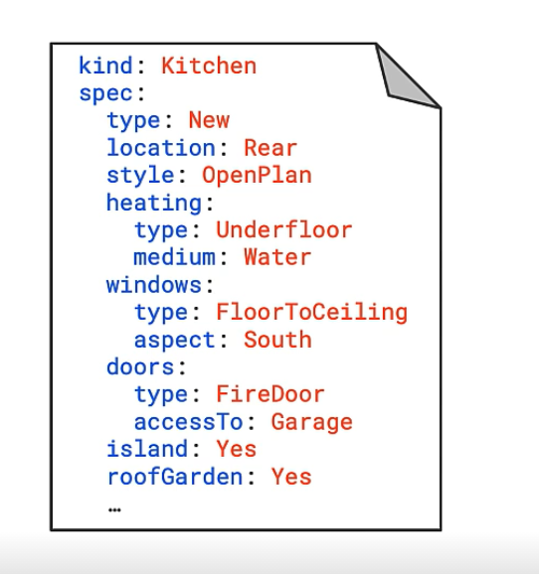
K8s work in Declarative state model– in the manifest file. Match observed state with desired state. If a node goes down, fires up a container in a pod or a new pod and a container on it. Does all that without involving us.
Notes:
In Slide Show mode, select the arrows to visit links.

Slide 16
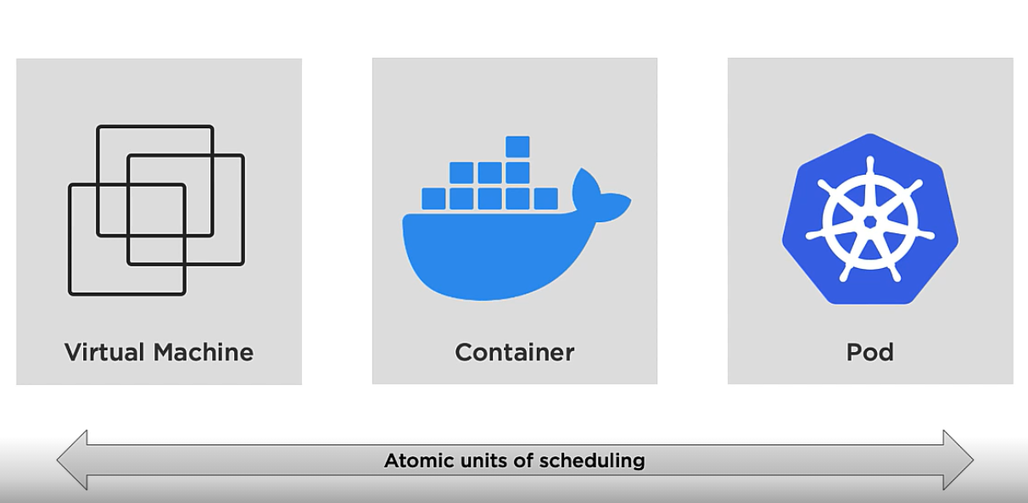
Pods – every app is in a container and container is in turn ran on a pod, in k8s u can’t have a container without a pod. It can be described as a shared execution environment. Shared storage , n/w space, memory. Containers running in a pod share this execution environment. -> We can have tight coupling and loose coupling i.e. Container in same pod vs container in different pods. Shared access vs network access. -> Remember Unit of scaling is pods and not containers.

Slide 17
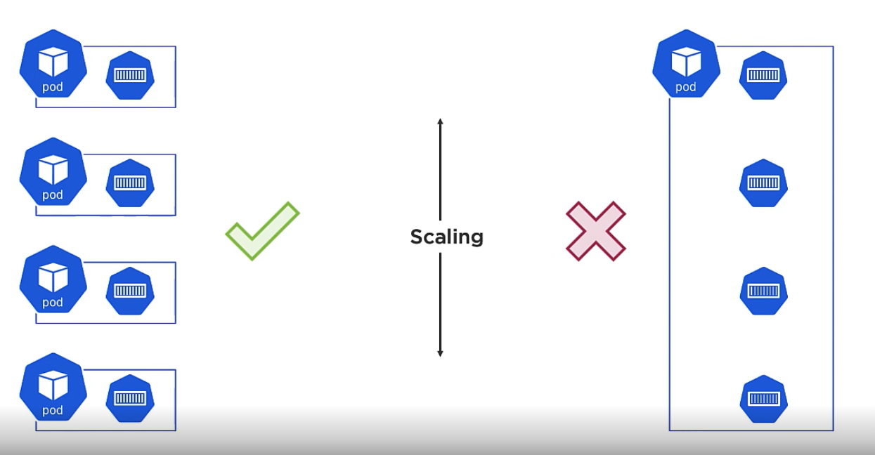

Slide 18
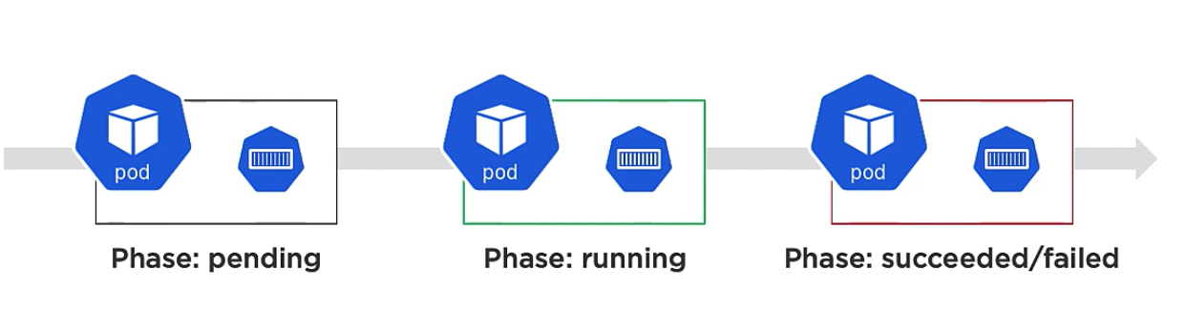
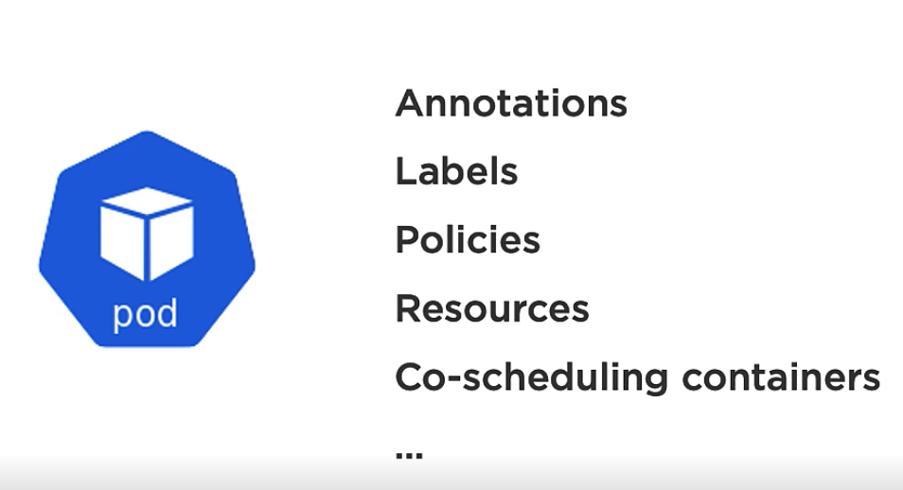
Important points for pod
A pod is always up whenever, all containers in it are up and running, it would never be the case that several containers in a pod are not up and u would say that the pod is up...NO
All self-healing part handled by deployments and services then why bother containers, bcz pods have Annotations, Labels….

Slide 19
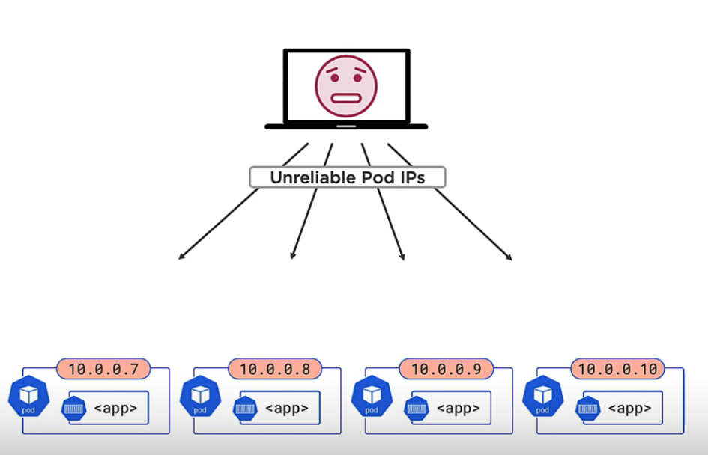
Unreliable IPs

Slide 20
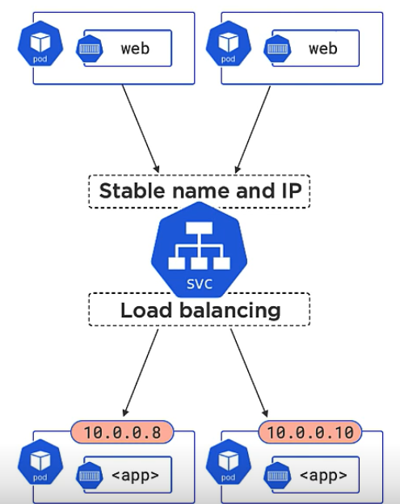
Service Objects
Stable networking with IPs, how to do – now since every pod comes with it’s own IP, how do we handle this – it can lead to IP churn, lots of, how to perform updates, what if a client was using it and then the pod dies and IP changes how to handle it?
Welcome k8s SERVICE OBJECTS. – It is a higher level abstraction for your pods with stable IP for DNS and it provides basic load balancing.

Slide 21
How does this service gets to know where to balance load?
Well it recognises pods with LABELS, labels are powerful. It is simply that the service asks all the pods with specific labels as version 2.0 and prod backend I m going to connect to you to balance load, others it doesn’t bother.

Slide 22
Game changer – Deployments in k8s The thing for self healing and auto scaling and 0 downtime
Deployment is a controller object, which watches the api server for new deployments. Implements them and keep the observed state matching to desired state.
You spec once and deploy many.
K8s api – like a catalog of all k8s object, there are pods, replicas, services, deployment objects and many more. All these reside in a manifest file, where we also state an app version.
api server is what exposes these via a restful api to us. HTTPs methods supported – put, get, post, delete. It is how we access the objects in api.

Slide 23
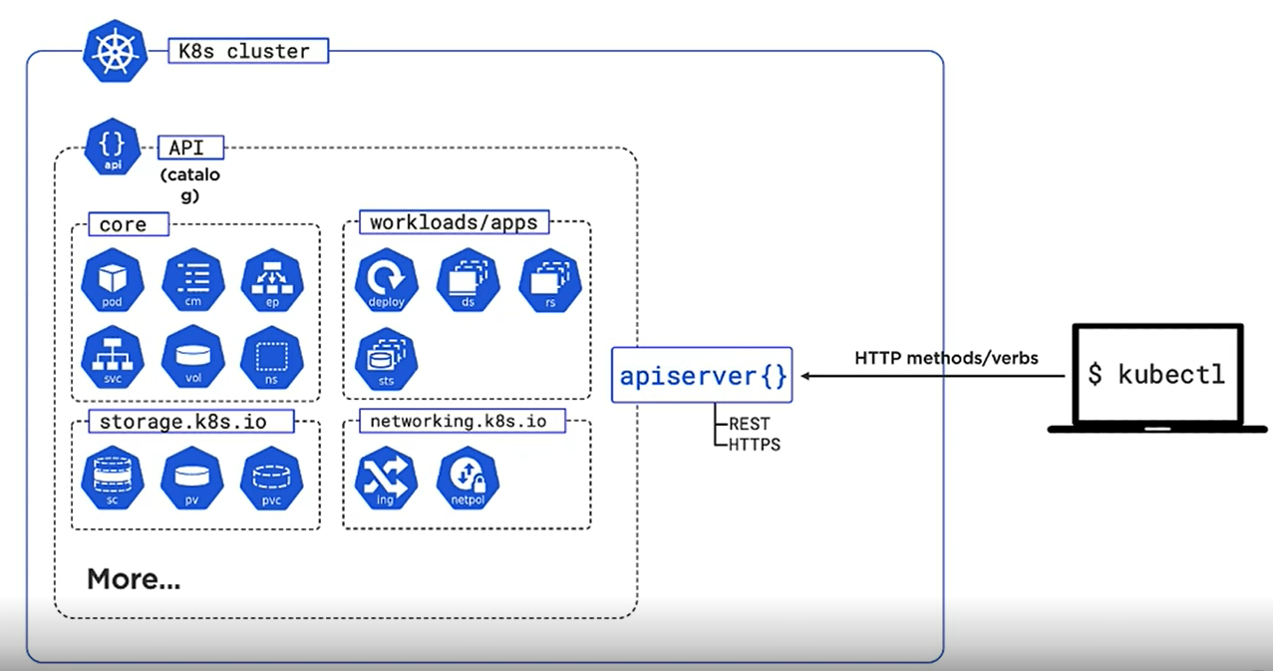

Slide 24
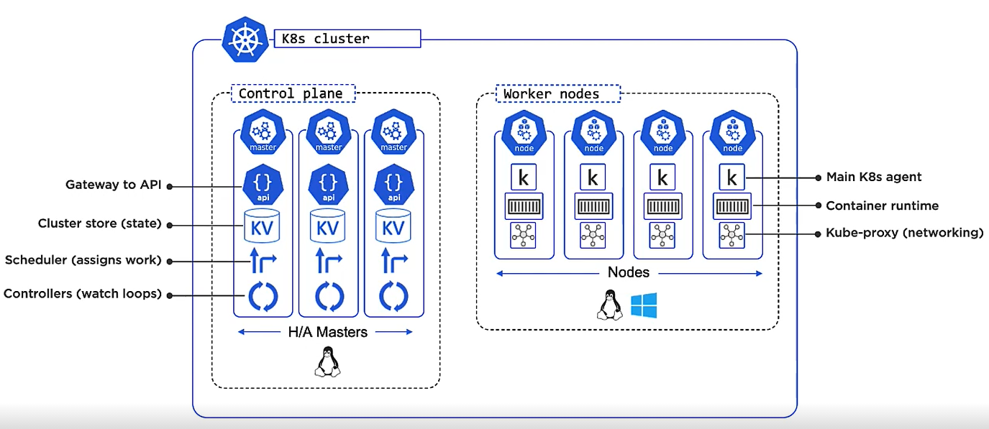
1

Slide 25
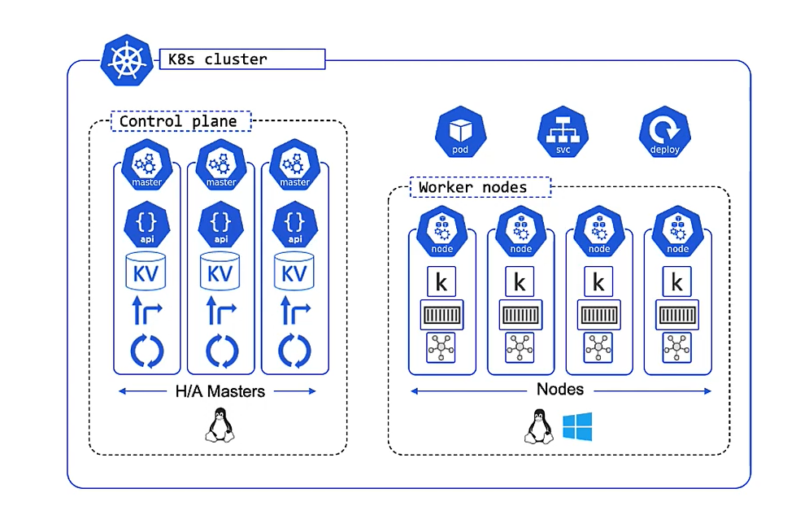

Slide 26
Hands On
1
You need Kubectl….a command line tool on laptop for k8s
Install-Script -Name 'install-kubectl' -Scope CurrentUser –Force
powershell -ExecutionPolicy Bypass install-kubectl.ps1 c:\kubectl
kubectl version –short
Set-ExecutionPolicy Bypass -Scope Process -Force; [System.Net.ServicePointManager]::SecurityProtocol = [System.Net.ServicePointManager]::SecurityProtocol -bor 3072; iex ((New-Object System.Net.WebClient).DownloadString('https://chocolatey.org/install.ps1’))
choco -?

Slide 27
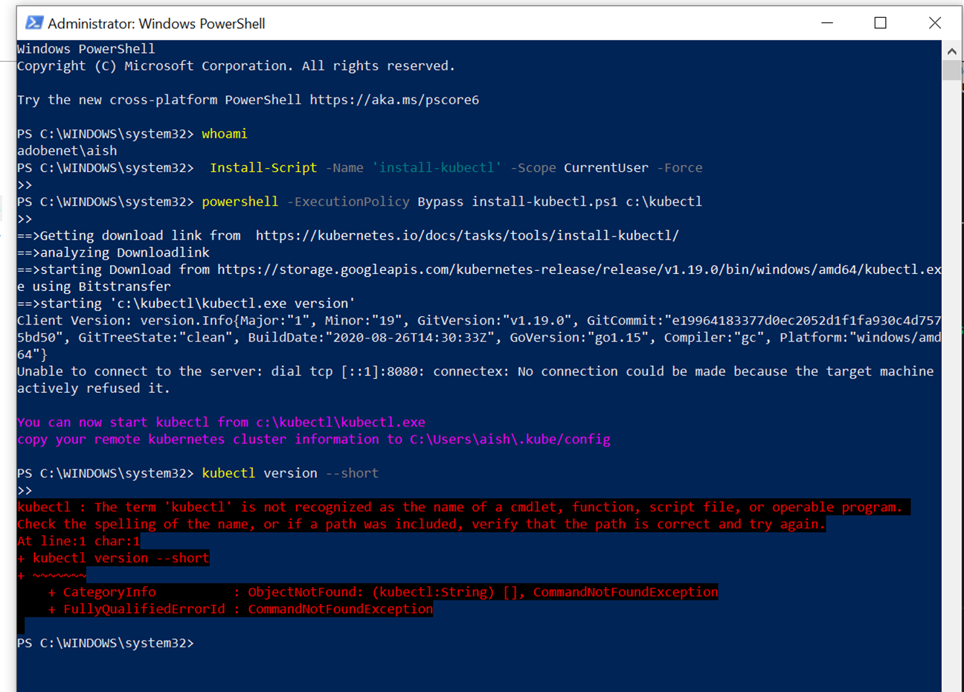

Slide 28
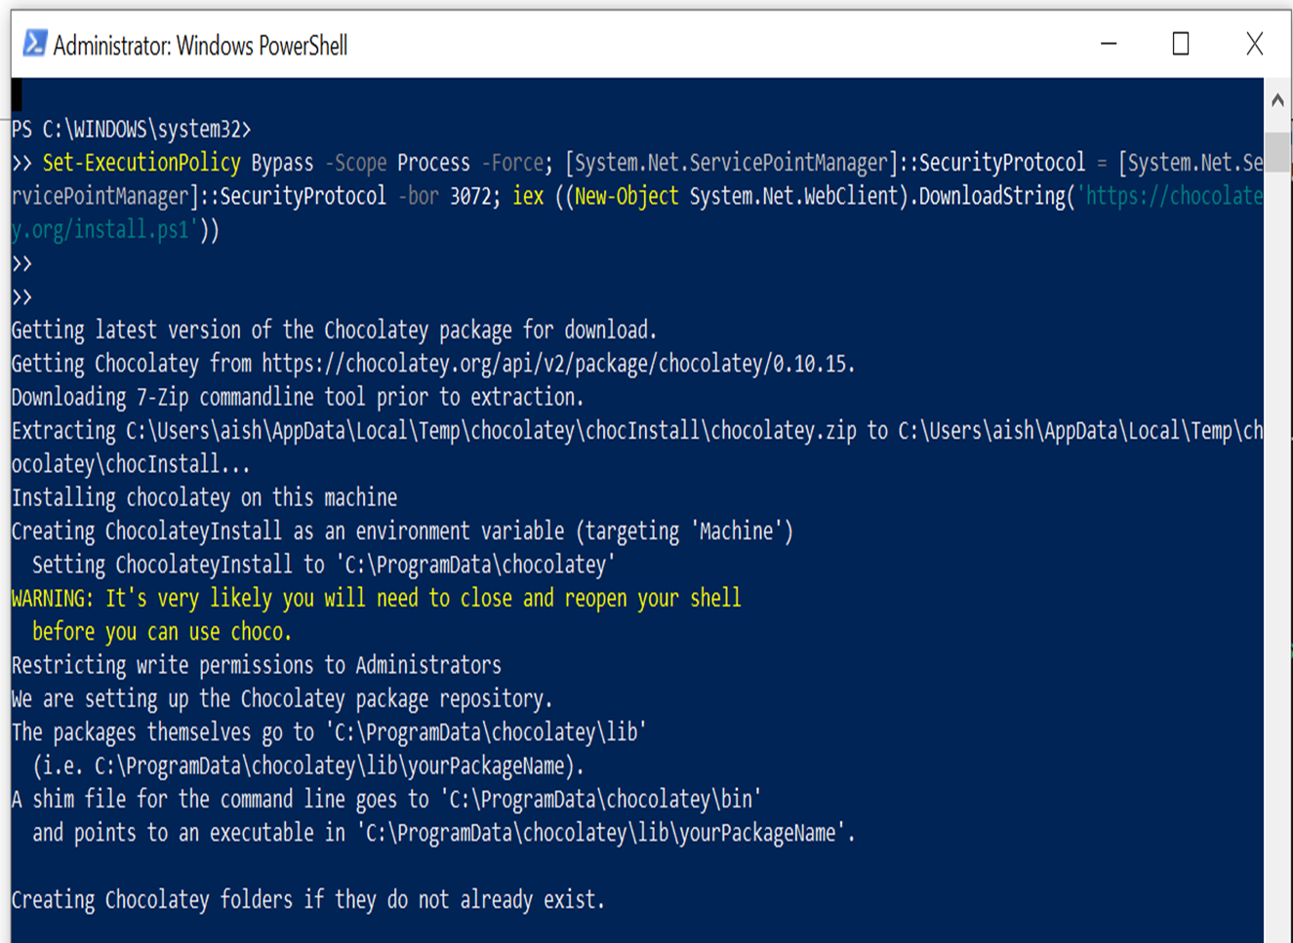

Slide 29
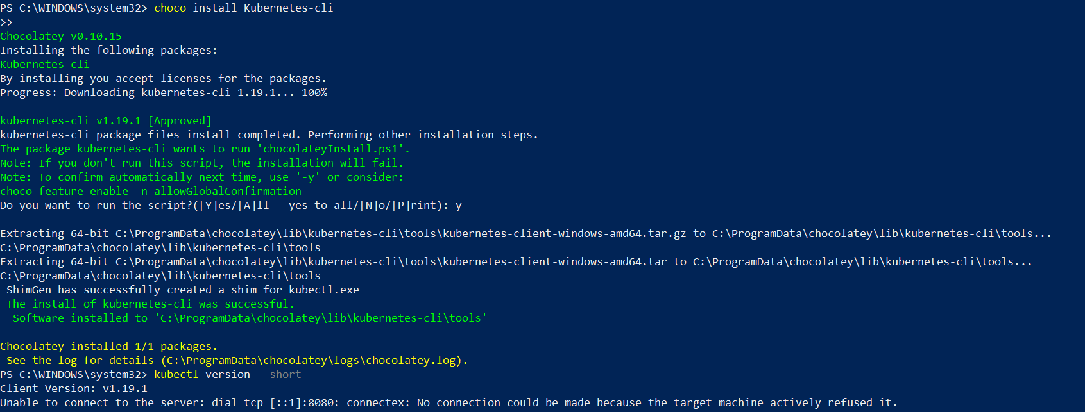
1
choco install Kubernetes-cli

Slide 30
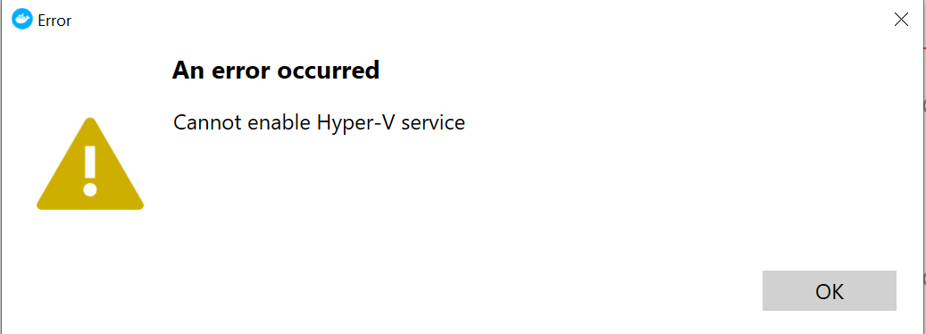
Get docker on laptop – Docker desktop or minikube
1
Google search - docker desktop for windows. I chose the edge version.
Enable-WindowsOptionalFeature -Online -FeatureName Microsoft-Hyper-V –All
Will have to do BIOS setup – to enable virtualization

Slide 31
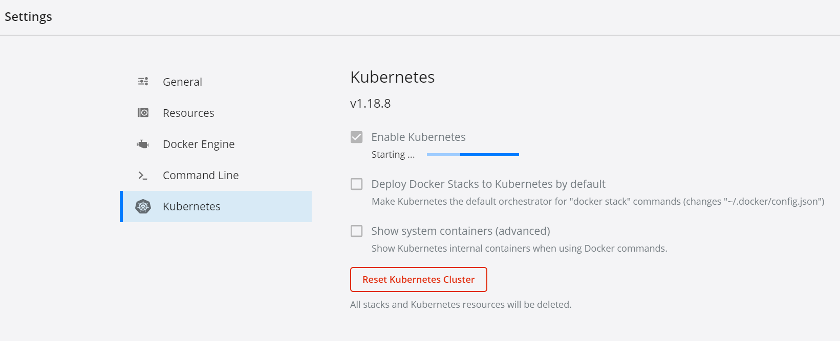
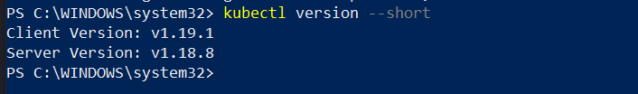
Enable k8s in docker desktop, 1st time may take a couple of minutes.

Slide 32
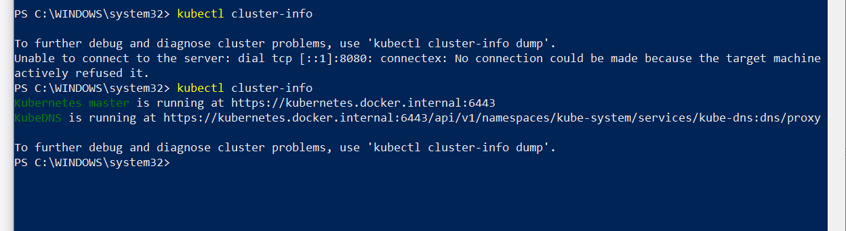

Slide 33
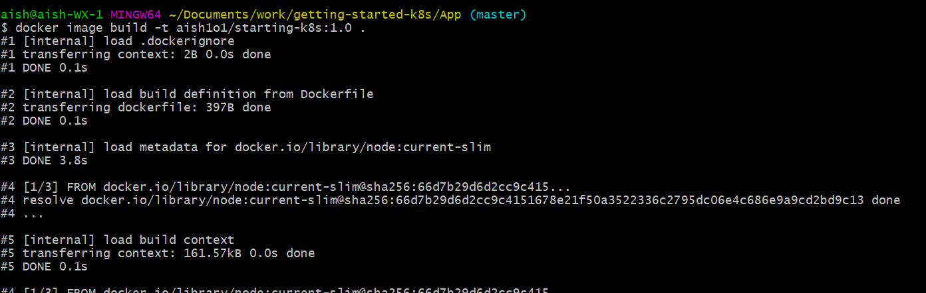
docker --version
Docker version 19.03.13, build 4484c46d9d
aish@aish-WX-1 MINGW64 ~/Documents/work/getting-started-k8s/App (master)
$ docker image build -t aish1o1/starting-k8s:1.0

Slide 34
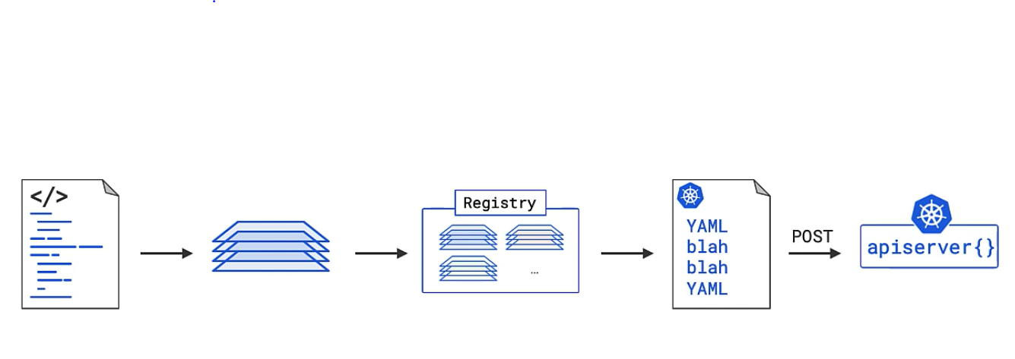
Running a pod – App deployment workflow
Start with app code ->make an image out of it -> store it in a registry /repo -> declare a manifest file ->
Host to the api-server
Initially we had a single monolithic api group but as things grew, need for subgrouping came and api sub group were created, now we have core api – subgroup most stable version, then there are different subgroups
Done to group together similar objects.
By default, images are hosted on docker hub and that’s where it will be searched if you don’t specify the DNS name.

Slide 35
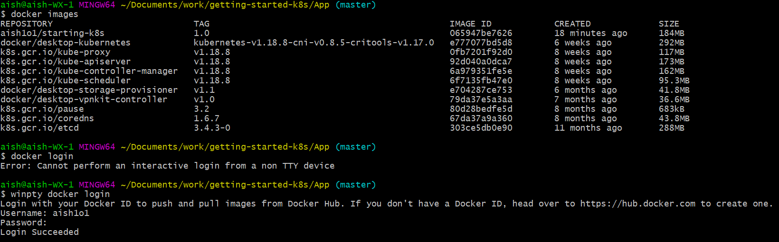
docker image push aish1o1/starting-k8s:1.0

Slide 36
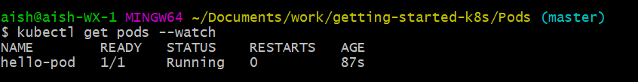
cd Pods
kubectl apply -f pods.yml
kubectl get pods –watch
Kubectl describe pods hello-pod

Slide 37
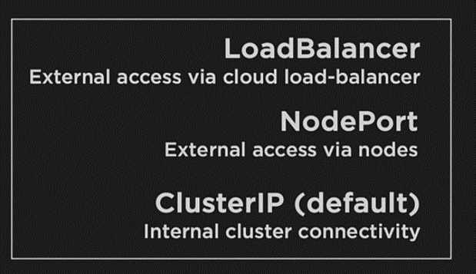
Services provide reliable networking for pods.
Cluster IP – for internal access
Node port – for external access. Creates a port for the service on every cluster node.
Load Balancer

Slide 38
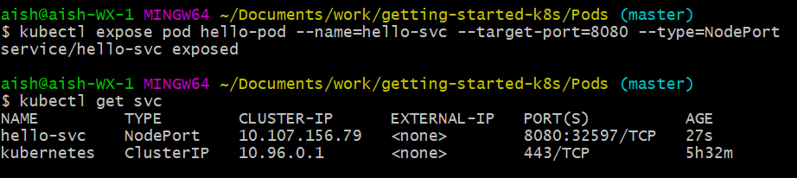
The imperative way and the declarative way of using services
kubectl expose pod hello-pod --name=hello-svc --target-port=8080 --type=NodePort
kubectl get svc
http://localhost:32597/ and you see the webpage. localhost if you are running cluster on laptop else the IP followed by port (if on cloud).

Slide 39
Deployments – The best for the last
Theory – being objects in the kubernetes api, in app api sub group.
In our current yaml for deployment, 5 identical containers, running the same image. Matching labels is how the deployment gets to know where to do the rolling update.
kubectl apply –f deploy.yml
kubectl get deploy
kubectl get rs

Slide 40
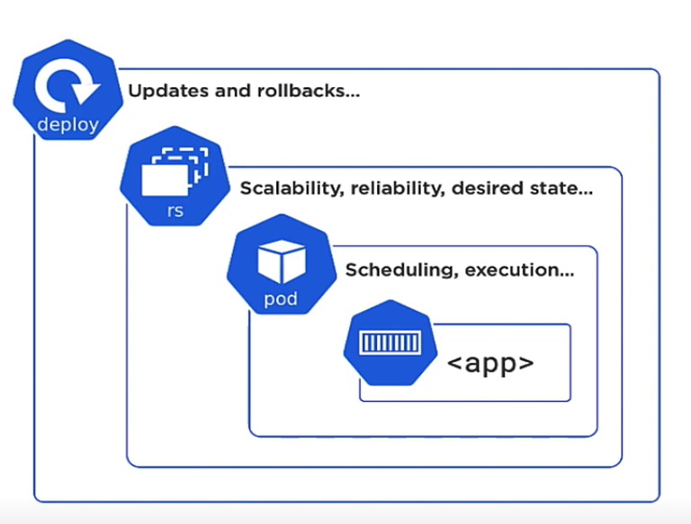
Self healing and scaling
Rolling updates
Versioned rollbacks
END.

